Slide 1


Rane Data Centre
Rane Group Industry 4.0

Slide 2

Industry 4.0
Prediction Workflow Architecture
Data Analysis + ML Prediction – Using PYTHON
Data collection
Pre process Data
Development of Predictive Models
Integrate Analytics with IGNITION System
Feature Extraction
Data Cleaning
Data Reduction and Transformation
Model Development
Parameter Optimization
Model Validation
Output will get displayed in Ignition UI
Data source from MSSQL Data base
1.Python libraries used for Analysis: Numpy,Pandas,Scikitlearn,Tensorflow,keras,Statsmodels,XGBoost,PyTorch,Matplotlib,Seaborn
2.ML Algorithms used for Prediction:
Linear Regression, Logistic Regression, Decision Trees, Random forest, Naïve bayes, KNN
Get input from MSSQL using Pymssql library
Send the processed output to Postgresql using Pscyopg2 library
Analysis output - Prediction score will be received in Postgresql or MSSQL
Development Environment : JUPYTER NOTEBOOK

Slide 3
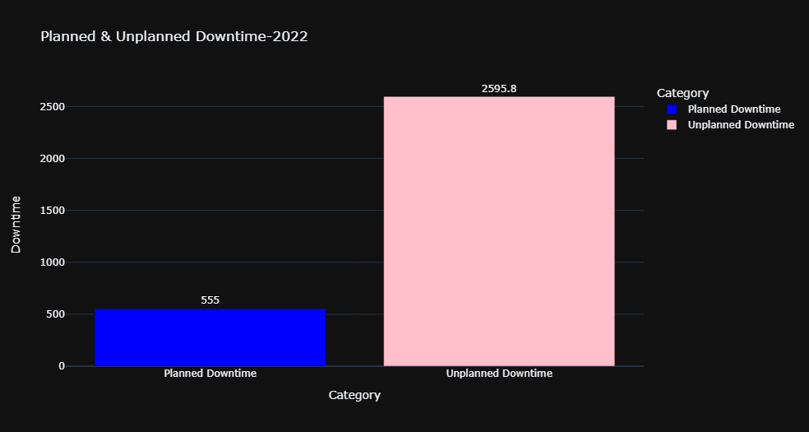
Industry 4.0
Downtime Data Analysis :
Data Source : Downtime Data of Makino -4 [Jan 2022 – Dec 2022 ]
No. of. Records : 33,974
Total Downtime : 3150/2357 hours
Planned – 555 hours
UnPlanned – 2595 hours/1803

Slide 4
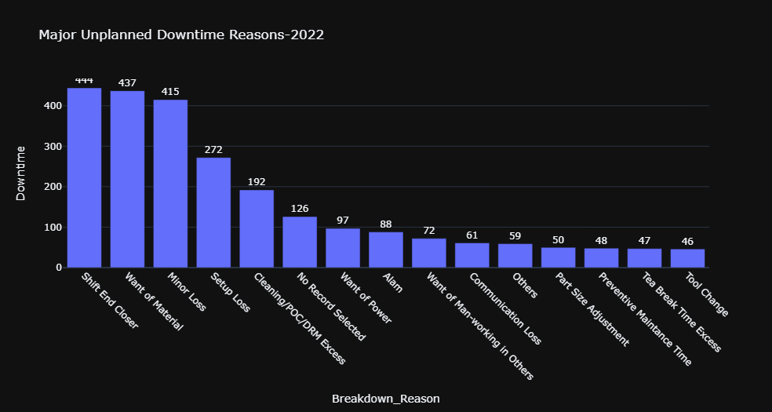
Industry 4.0
Breakdown Reason | Downtime( hours) | Percentage of Total Unplanned Downtime-2595hrs
Shift End Closer | 444 | 17.3 %
Want of Material | 437 | 16.6%
Minor Loss | 415 | 16.4 %
Setup Loss | 272 | 10%
Cleaning/POC/DRM Excess | 192 | 7%
No Record Selected | 126 | 5%
Want of Power | 97 | 4%
Alam | 88 | 3%
Want of Man-working in Others | 72 | 3%
Communication Loss | 61 | 2%
Others | 59 | 2%
Part Size Adjustment | 50 | 2%
Preventive Maintenance Time | 48 | 2%
Tea Break Time Excess | 47 | 2%
Tool Change | 46 | 2%
Analysis by Downtime reasons:
Total Unplanned Downtime Reasons : 32
Major Unplanned Downtime Reasons : 15

Slide 5
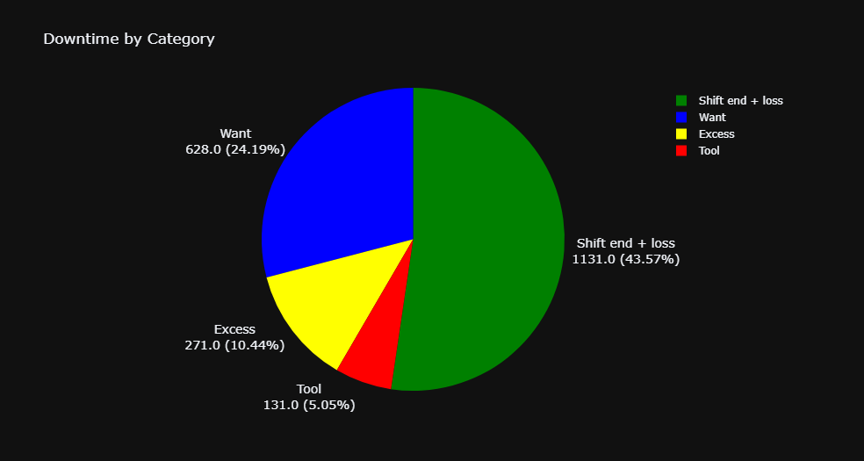
Industry 4.0

Slide 6
Industry 4.0
Priority 1 -Category : Want
Priority 2 -Category : Excess
Breakdown Reason | Downtime( hours) | Percentage of Total Unplanned Downtime
Want of Material | 437 | 16.4%
Want of Power | 97 | 3.8%
Want of Man-working in Others | 72 | 3%
Want of Air | 19 | 1%
Want of Oil | 3 | 0.1%
Total | 628 hrs | 24.30%
Breakdown Reason | Downtime( hours) | Percentage of Total Unplanned Downtime
Cleaning/POC/DRM Excess | 192 | 7%
Tea Break Time Excess | 47 | 2%
Lunch Break Time Excess | 32 | 1%
Total | 271 hrs | 10%
Priority 3 -Category : Tool
Priority 4- Category : Loss
Breakdown Reason | Downtime( hours) | Percentage of Total Unplanned Downtime
Part Size Adjustment | 50 | 2%
Tool Change | 46 | 2.05%
Parts Failure | 18 | 0.5%
Tool Offset | 17 | 0.5%
Total | 131hrs | 5.05%
Breakdown Reason | Downtime( hours) | Percentage of Total Unplanned Downtime
Shift End Closer | 444 | 17%
Minor Loss | 415 | 16%
Setup Loss | 272 | 10%
Total | 1131 hrs | 43%

Slide 7
Industry 4.0
Inference:
Total Downtime (Excess, loss, Tool, Want) = 2161 hrs
Percentage = 82% of Unplanned Downtime
Machine Availability = 4364 hrs ≈75%
Parts produced = 94184
Reduction in downtime (hrs) | Improved Machine Availability (hrs) | Increase in Availability (%) | Increase in part count(Nos)
10 % = 216.1 | 4580.1 | 4.9 % | 4709
25 % = 540.2 | 4904.25 | 12.4 % | 11,660
50 % = 1080 | 5445 | 24.7 % | 23,320

Slide 8
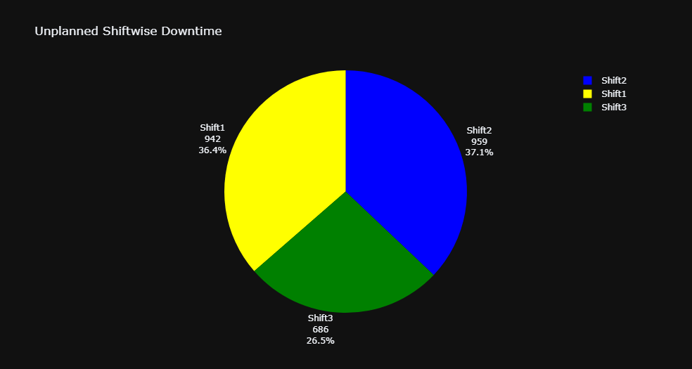
Industry 4.0
Shiftwise Analysis:
Inference :
Most of the Downtime has Occurred in Shift 2 and Shift 1

Slide 9

Industry 4.0
Thank You

